Slide 1
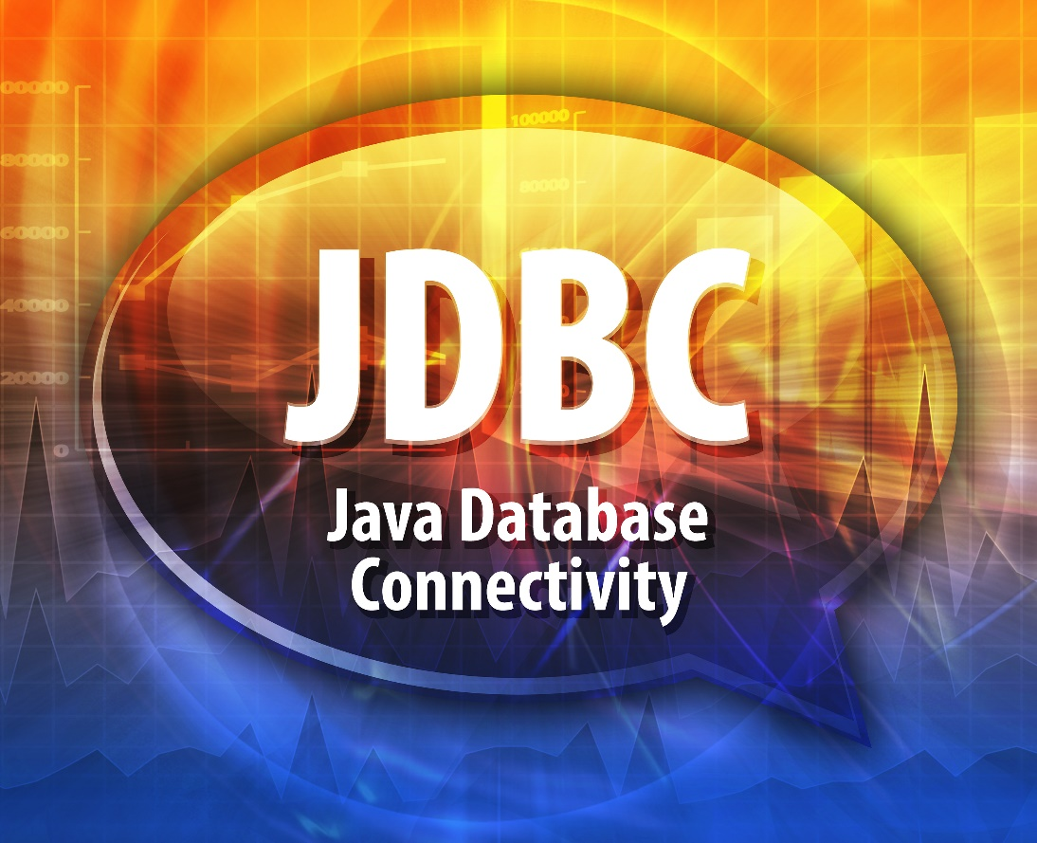
JDBC
Driver Manager
Statements
Result Sets
Query Parameters
Auto Closeable

Slide 2

See Also
http://www.tutorialspoint.com/jdbc/jdbc-sample-code.htm
http://www.java2novice.com/jdbc/
Notes:
Some additional information on concurrency

Slide 3
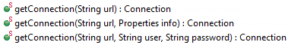
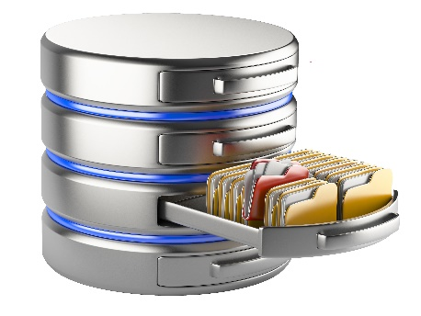
Parts of JDBC
Connection
DriverManager
JDBC Driver
Streams of bytes … two ways (into your program and out of your program)
Disks, consoles, sockets, keyboards, printers
Know how to talk streams and you can talk to anything
Initialization (constructor) is different. Use is the same.

Slide 4
Parts of JDBC
Connection
Statement
DriverManager
JDBC Driver
Streams of bytes … two ways (into your program and out of your program)
Disks, consoles, sockets, keyboards, printers
Know how to talk streams and you can talk to anything
Initialization (constructor) is different. Use is the same.

Slide 5
Parts of JDBC
Connection
Statement
ResultSet
DriverManager
JDBC Driver
Streams of bytes … two ways (into your program and out of your program)
Disks, consoles, sockets, keyboards, printers
Know how to talk streams and you can talk to anything
Initialization (constructor) is different. Use is the same.

Slide 6
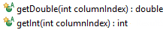

Parts of JDBC
Connection
Statement
ResultSet
DriverManager
JDBC Driver
Streams of bytes … two ways (into your program and out of your program)
Disks, consoles, sockets, keyboards, printers
Know how to talk streams and you can talk to anything
Initialization (constructor) is different. Use is the same.

Slide 7
DriverManager and Connection
import org.apache.derby.jdbc.ClientDriver;
public class Tinker {
static {
System.out.println("HERE");
}
public static void main(String[] args) throws Exception {
Class.forName("org.apache.derby.jdbc.ClientDriver");
Class.forName("com.mysql.jdbc.Driver");
Class.forName("blah");
Connection conn = DriverManager.getConnection("jdbc:derby://localhost/grades");
// ...
conn.close();
}
}
Streams of bytes … two ways (into your program and out of your program)
Disks, consoles, sockets, keyboards, printers
Know how to talk streams and you can talk to anything
Initialization (constructor) is different. Use is the same.

Slide 8
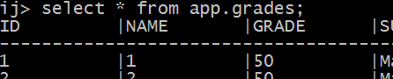
Making a Statement
Connection conn = DriverManager.getConnection("jdbc:derby://localhost/grades");
Statement stmt = conn.createStatement();
boolean type = stmt.execute("select * from app.horses");
boolean type = stmt.execute("update app.grades set grade=50");
boolean type = stmt.execute("select * from app.grades");
ResultSet rs = stmt.getResultSet();
int nr = stmt.getUpdateCount();
System.out.println(type+":"+nr+":"+rs);
stmt.close();
conn.close();
Exception
Update Count
Result Set
Streams of bytes … two ways (into your program and out of your program)
Disks, consoles, sockets, keyboards, printers
Know how to talk streams and you can talk to anything
Initialization (constructor) is different. Use is the same.

Slide 9
Making a Statement
Connection conn = DriverManager.getConnection("jdbc:derby://localhost/grades");
Statement stmt = conn.createStatement();
int nr = stmt.executeUpdate("update app.grades set grade=50");
System.out.println(nr);
ResultSet rs = stmt.executeQuery("select * from app.grades");
// ...
rs.close();
ResultSet rs2 = stmt.executeQuery("select * from app.phones");
// ...
rs2.close();
stmt.close();
conn.close();
Streams of bytes … two ways (into your program and out of your program)
Disks, consoles, sockets, keyboards, printers
Know how to talk streams and you can talk to anything
Initialization (constructor) is different. Use is the same.

Slide 10

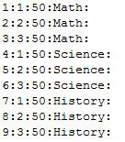
Result Sets
Connection conn = DriverManager.getConnection("jdbc:derby://localhost/grades");
Statement stmt = conn.createStatement();
ResultSet rs = stmt.executeQuery("select * from app.grades");
while(rs.next()) {
System.out.println(
rs.getInt(1)+":"+ // starts with ONE
rs.getInt(2)+":"+
rs.getInt("grade")+":"+
rs.getString(4)+":"
);
}
rs.close();
stmt.close();
conn.close();
Streams of bytes … two ways (into your program and out of your program)
Disks, consoles, sockets, keyboards, printers
Know how to talk streams and you can talk to anything
Initialization (constructor) is different. Use is the same.

Slide 11

All SQL is Welcome
Statement stmt = conn.createStatement();
stmt.execute("create table app.users (name varchar(10), password varchar(10))");
stmt.execute("insert into app.users values ('admin','root')");
stmt.execute("insert into app.users values ('jane','12345')");
stmt.execute("insert into app.users values ('bob','a')");
stmt.close();
Streams of bytes … two ways (into your program and out of your program)
Disks, consoles, sockets, keyboards, printers
Know how to talk streams and you can talk to anything
Initialization (constructor) is different. Use is the same.

Slide 12

Query Parameters
Statement stmt = conn.createStatement();
String u = "jane";
String p = "12345";
String q = "select * from app.users where name='" + u + "' and password='" + p + "'";
select * from app.users where name='jane' and password='12345'
ResultSet rs = stmt.executeQuery(q);
if(rs.next()) {
System.out.println("You are logged in as '"+rs.getString(1)+"'");
} else {
System.out.println("Access denied");
}
Streams of bytes … two ways (into your program and out of your program)
Disks, consoles, sockets, keyboards, printers
Know how to talk streams and you can talk to anything
Initialization (constructor) is different. Use is the same.

Slide 13
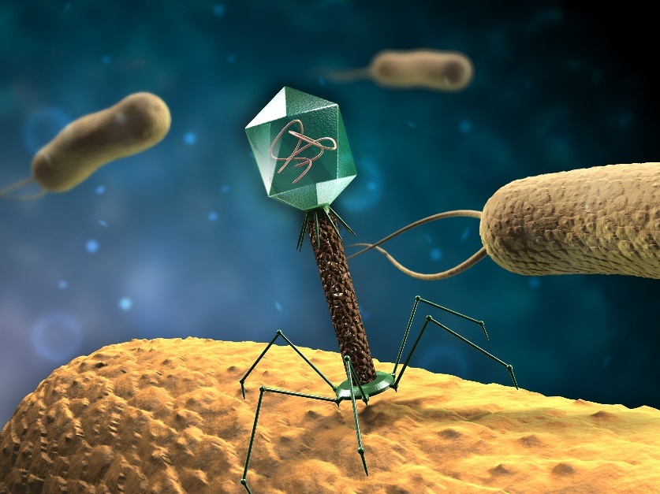
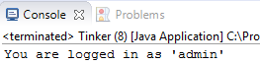
SQL Injection
String u = "jane";
String p = "' or ''='";
String q = "select * from app.users where name='" + u + "' and password='" + p + "'";
select * from app.users where name='jane' and password='' or ''=''
ResultSet rs = stmt.executeQuery(q);
if(rs.next()) {
System.out.println("You are logged in as '"+
rs.getString(1)+"'");
}
Streams of bytes … two ways (into your program and out of your program)
Disks, consoles, sockets, keyboards, printers
Know how to talk streams and you can talk to anything
Initialization (constructor) is different. Use is the same.

Slide 14

PreparedStatement
Connection conn = DriverManager.getConnection("jdbc:derby://localhost/grades");
PreparedStatement stmt = conn.prepareStatement("select * from users where name=? and password=?");
String u = "jane";
String p = "' or ''='";
stmt.setString(1, u);
stmt.setString(2, p);
ResultSet rs = stmt.executeQuery();
if(rs.next()) {
System.out.println("You are logged in as '"+rs.getString(1)+"'");
} else {
System.out.println("Access denied");
}
rs.close();
stmt.close();
conn.close();
Compiled (prepared) for repeats
Sanitizes the parameter inputs
Streams of bytes … two ways (into your program and out of your program)
Disks, consoles, sockets, keyboards, printers
Know how to talk streams and you can talk to anything
Initialization (constructor) is different. Use is the same.

Slide 15
Autocloseable
Connection conn = DriverManager.getConnection("jdbc:derby://localhost/grades");
PreparedStatement stmt = conn.prepareStatement("select * from users where name=? and password=?");
String u = "jane";
String p = "' or ''='";
stmt.setString(1, u);
stmt.setString(2, p);
ResultSet rs = stmt.executeQuery();
if(rs.next()) {
System.out.println("You are logged in as '"+rs.getString(1)+"'");
} else {
System.out.println("Access denied");
}
rs.close();
stmt.close();
conn.close();
Streams of bytes … two ways (into your program and out of your program)
Disks, consoles, sockets, keyboards, printers
Know how to talk streams and you can talk to anything
Initialization (constructor) is different. Use is the same.

Slide 16
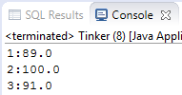
Autocloseable
try(Connection conn = DriverManager.getConnection("jdbc:derby://localhost/grades")) {
String q = "select * from app.grades where subject=?";
try(PreparedStatement stmt = conn.prepareStatement(q)) {
stmt.setString(1, "History");
try(ResultSet rs = stmt.executeQuery()) {
while(rs.next()) {
System.out.println(rs.getString(2) + ":" + rs.getDouble(3));
}
} // close(rs)
} // close(stmt)
} // close(conn)
Streams of bytes … two ways (into your program and out of your program)
Disks, consoles, sockets, keyboards, printers
Know how to talk streams and you can talk to anything
Initialization (constructor) is different. Use is the same.

Slide 17
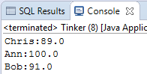
Autocloseable
try(Connection conn = DriverManager.getConnection("jdbc:derby://localhost/grades")) {
String q = "select "+
"phones.name, grades.grade "+
"from "+
"grades, phones "+
"where "+
"grades.name=phones.id and subject=?";
try(PreparedStatement stmt = conn.prepareStatement(q)) {
stmt.setString(1, "History");
try(ResultSet rs = stmt.executeQuery()) {
while(rs.next()) {
System.out.println(rs.getString(1) + ":" + rs.getDouble(2));
}
}
}
}
Streams of bytes … two ways (into your program and out of your program)
Disks, consoles, sockets, keyboards, printers
Know how to talk streams and you can talk to anything
Initialization (constructor) is different. Use is the same.

Slide 18

Tinkering
Write a program to take a student’s name (not id), grade, and subject – enter the record into the database.
Write a program to take a student name (not id) – print all the grades for that student.
Notes:
Here are some things to think about … nothing to submit.
Share your thoughts in the online portal discussion area.

